Slide 1
CompTIA Security+ Guide to Network Security Fundamentals, Sixth Edition
Chapter 12
Access Management

Slide 2
Objectives
12.1 Define access management and list the access control models
12.2 Describe how to manage access through account management
12.3 List the best practices for access control
12.4 Describe how to implement access control
12.5 Explain the different types of identity and access services

Slide 3
What is Access Control?
Access Control
Granting or denying approval to use specific resources
Physical access control
Consists of fencing, hardware door locks, and mantraps to limit contact with devices
Technical access control
Consists of technology restrictions that limit users on computers from accessing data
There are standard access control models that are used to help enforce access control

Slide 4
Access Control Terminology (1 of 5)
Identification
Presenting credentials
Example: delivery driver presenting employee badge
Authentication
Checking the credentials
Example: examining the delivery driver’s badge
Authorization
Granting permission to take action
Example: allowing delivery driver to pick up package
Accounting
A record that is preserved of who accessed the network, what resources they accessed, and when they disconnected

Slide 5
Access Control Terminology (2 of 5)
Action | Description | Scenario example | Computer process
Identification | Review of credentials | Delivery person shows employee badge | User enters user name
Authentication | Validate credentials as genuine | Gabe reads badge to determine it is real | User provides password
Authorization | Permission granted for admittance | Gabe opens door to allow delivery person in | User authorized to log in
Access | Right given to access specific resources | Delivery person can only retrieve box by door | User allowed to access only specific data
Accounting | Record of user actions | Gabe signs to confirm the package was picked up | Information recorded in log file

Slide 6
Access Control Terminology (3 of 5)
Object
A specific resource
Example: file or hardware device
Subject
A user or process functioning on behalf of a user
Example: computer user
Operation
The action taken by the subject over an object
Example: deleting a file

Slide 7
Access Control Terminology (4 of 5)
Role | Description | Duties | Example
Privacy officer | Manager who oversees data privacy compliance and manages data risk | Ensures the enterprise complies with data privacy laws and its own privacy policies | Decides that users can have permission to access SALARY.X L S X
Custodian or steward | Individual to whom day-to-day actions have been assigned by the owner | Periodically reviews security settings and maintains records of access by end users | Sets and reviews security settings on SALARY.X L S X
Owner | Person responsible for the information | Determines the level of security needed for the data and delegates security duties as required | Determines that the file SALARY.X L S X can be read only by department managers
End user | User who access information in the course of routine job responsibilities | Follows organization’s security guidelines and does not attempt to circumvent security | Opens SALARY.X L S X

Slide 8
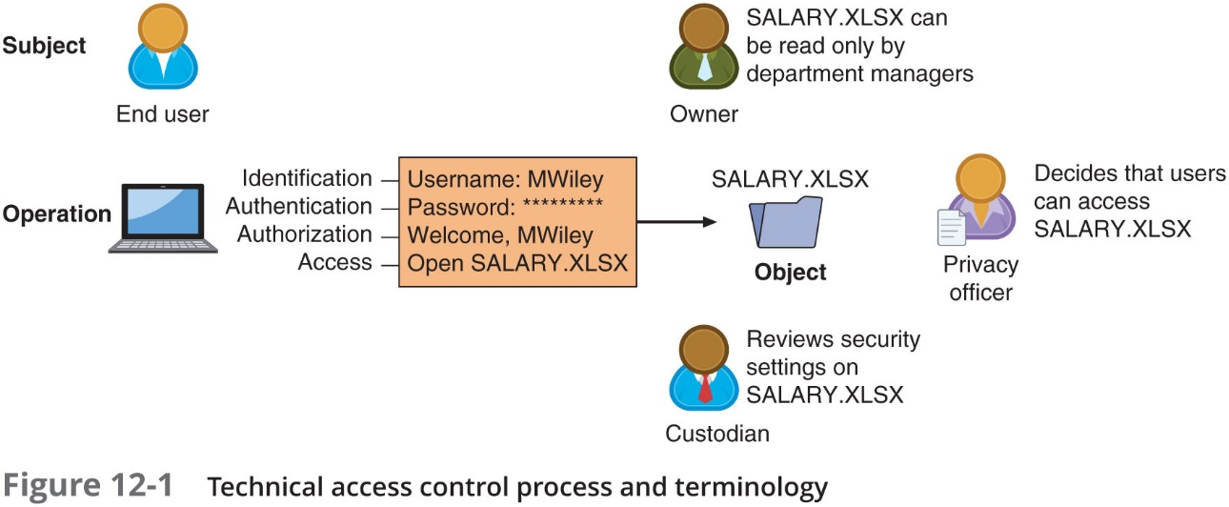
Access Control Terminology (5 of 5)

Slide 9
Access Control Models
Access control model
Standards that provide a predefined framework for hardware or software developers
Use the appropriate model to configure the necessary level of control
Five major access control models
Discretionary Access Control (D A C)
Mandatory Access Control (M A C)
Role Based Access Control (R B A C)
Rule Based Access Control
Attribute-Based Access Control (A B A C)

Slide 10
Discretionary Access Control (D A C) (1 of 2)
Least restrictive model
Every object has an owner
Owners have total control over their objects
Owners can give permissions to other subjects over their objects
Used on operating systems such as most types of U N I X and Microsoft Windows
Two significant weaknesses:
Poses a risk in that it relies on decision by the end user to set the proper level of security
A subject’s permissions will be “inherited” by any programs that the subject executes

Slide 11
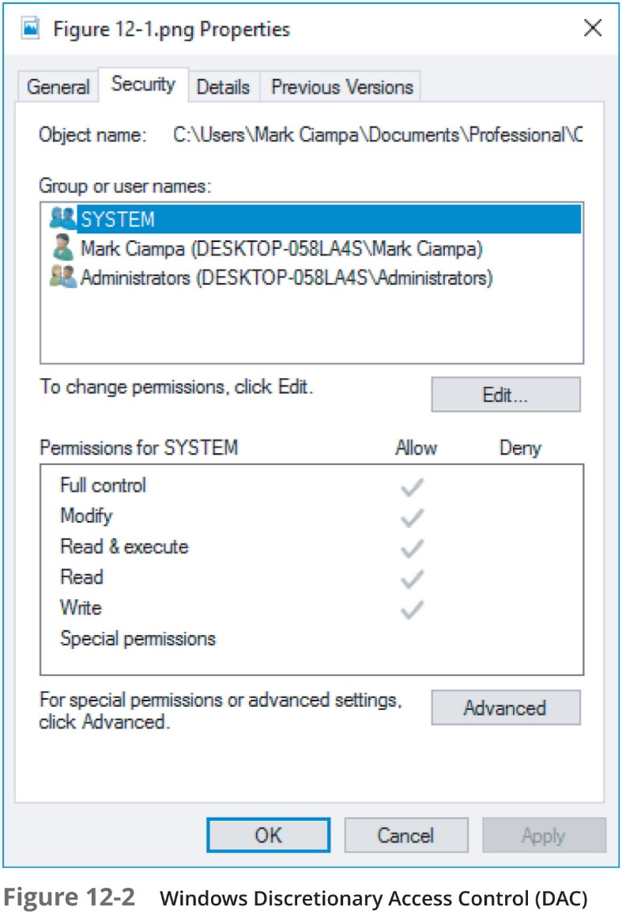
Discretionary Access Control (D A C) (2 of 2)

Slide 12
Mandatory Access Control (M A C) (1 of 4)
Most restrictive access control model
User has no freedom to set any controls or distribute access to other subjects
Typically found in military settings
Two elements
Labels - Every entity is an object and is assigned a classification label that represents the relative importance of the object
Subjects are assigned a privilege label (clearance)
Levels - a hierarchy based on the labels is used
Top secret has a higher level than secret, which has a higher level than confidential
M A C grants permissions by matching object labels with subject labels
Labels indicate level of privilege

Slide 13
Mandatory Access Control (M A C) (2 of 4)
To determine if file may be opened:
Object and subject labels are compared
The subject must have equal or greater level than object to be granted access
Two major implementations of M A C
Lattice model and Bell-LaPadula model
Lattice model
Subjects and objects are assigned a “rung” on the lattice
Multiple lattices can be placed beside each other
Bell-LaPadula (B L P) model
Similar to lattice model
Subjects may not create a new object or perform specific functions on lower level objects

Slide 14
Mandatory Access Control (M A C) (3 of 4)
Microsoft Windows uses a M A C implementation called Mandatory Integrity Control (M I C)
A security identifier (S I D) is issued to the user, group, or session
Each time a user logs in, the S I D is retrieved from the database for that user
S I D is used to identify user with subsequent interactions with Windows
Windows links the S I D to an integrity level
User Access Control (U A C) - a Windows feature that controls user access to resources

Slide 15
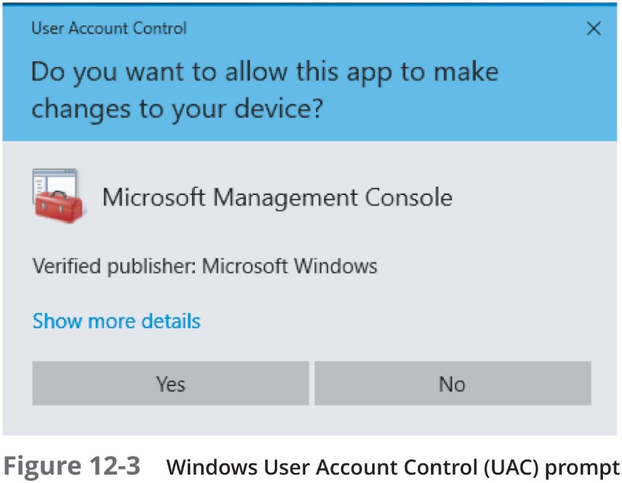
Mandatory Access Control (M A C) (4 of 4)

Slide 16
Role-Based Access Control
Role Based Access Control (R B A C)
Also called Non-Discretionary Access Control
Access permissions are based on user’s job function
R B A C assigns permissions to particular roles in an organization
Users are assigned to those roles

Slide 17
Rule-Based Access Control
Also called Rule-Based Role-Based Access Control (R B-R B A C)
Dynamically assigns roles to subjects based on a set of rules defined by a custodian
Each resource object contains access properties based on the rules
When user attempts access, system checks object’s rules to determine access permission
Often used for managing user access to one or more systems
Business changes may trigger application of the rules specifying access changes

Slide 18
Attribute-Based Access Control (1 of 2)
Uses more flexible polices than Rule-Based A C
Can combine attributes
Policies can take advantage of attributes such as:
Object attributes
Subject attributes
Environment attributes
A B A C rules can be formatted using an If-Then-Else structure

Slide 19
Attribute-Based Access Control (2 of 2)
Name | Explanation | Description
Mandatory Access Control (M A C) | End user cannot set controls | Most restrictive model
Discretionary Access Control (D A C) | Subject has total control over objects | Least restrictive model
Role-Based Access Control (R B A C) | Assigns permissions to particular roles in the organization and then users are assigned to roles | Considered a more “real-world” approach
Rule-Based Access Control | Dynamically assigns roles to subjects based on a set of rules defined by a custodian | Used for managing user access to one or more systems
Attribute-Based Access Control (A B A C) | Uses policies that can combine attributes | Most flexible model

Slide 20
Managing Access Through Account Management
Properly configuring accounts is a first step in providing strong security
Accounts include not only user accounts but also:
Service accounts
Privileged accounts
Account management includes account setup as well as account auditing

Slide 21
Account Setup
When initially setting up an account, take these into consideration:
Employee accounts
Creating location-based policies
Establishing standard naming conventions
Creating time-of-day restrictions
Enforcing least privilege

Slide 22
Employee Accounts (1 of 2)
Employee Accounts are often the source of entry points by threat actors
Employee Onboarding
Refers to the tasks associated with hiring a new employee
Onboarding steps:
Scheduling
Job duties
Socializing
Work space
Training
In addition, in a Microsoft Windows environment the steps may include:
Provision the new computer
Create email mailboxes and A D users
Add user accounts to groups
Create home folder
Review security settings

Slide 23
Employee Accounts (2 of 2)
Employee offboarding
Actions to be taken when an employee leaves an enterprise
Steps include:
Back up all employee files from local computer and server
Archive email
Forward email to a manager or coworker
Hide the name from the email address book
Orphaned accounts – user accounts that remain active after an employee has left
Dormant account – an account that has not been accessed for a lengthy period
Many organizations disable accounts for a minimum of 30 days and then purge disabled accounts twice per year

Slide 24
Location-Based Policies
Geofencing relies upon location-based policies
Or establishing the geographical boundaries of where a mobile device can and cannot be used
Polices are often first prescribed by generating an I P location data file
Which is a text file containing comma separated fields in the format I P_From, I P_To, Country_Code, Country_Name, Region, City
This policy then becomes the basis for how authorization requests from mobile devices are evaluated

Slide 25
Standard Naming Conventions
Standard naming conventions
“Rules” that have been established for creating account names
Options typically include:
First initial of first name followed by last name,
First name with a punctuation mark followed by last name
Last name followed by department code
In the event two names appear to be the same
A standard policy should be established for resolving conflicts

Slide 26
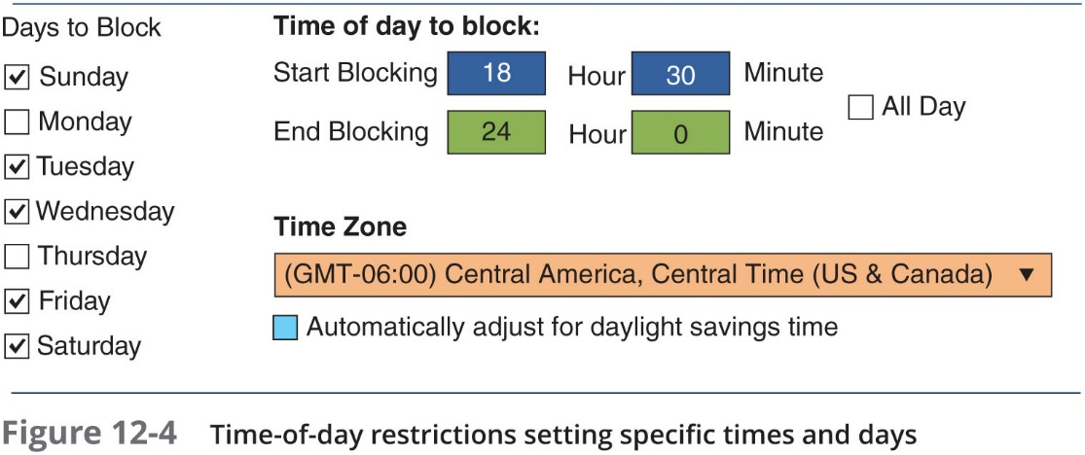
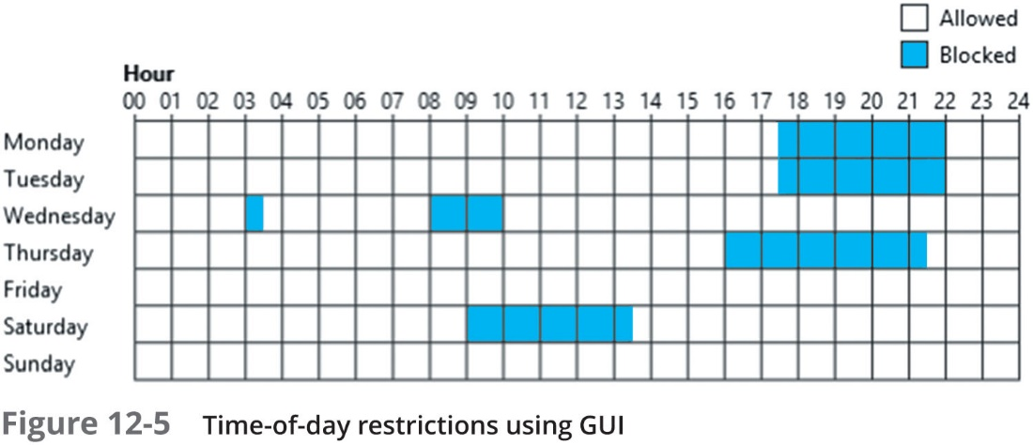
Time-of-Day Restrictions
Time-of-day restrictions can be used to limit when a user can log into their account

Slide 27
Least Privilege
Least privilege in access control
Means that only the minimum amount of privileges necessary to perform a job or function should be allocated
Helps reduce the attack surface by eliminating unnecessary privileges that could provide an avenue for an attacker
Should apply both to user accounts and to processes running on the system

Slide 28
Account Auditing
Once accounts have been created, they should be periodically maintained and audited using the following audits:
Recertification – the process of periodically revalidating a user’s account, access control, and membership role
Permission auditing and review – intended to examine the permissions that a user has been given to determine if each is still necessary
Usage auditing and review – an audit process that looks at the applications that the user is provided, how frequently they are used, and how they are being used

Slide 29
Best Practices for Access Control
Establishing best practices for limiting access
Can help secure systems and data
Examples of best practices
Separation of duties
Job rotation
Mandatory vacations
Clean desk policy

Slide 30
Separation of Duties
Separation of duties
Fraud can result from a single user being trusted with complete control of a process
Requires two or more people responsible for functions related to handling money
The system is not vulnerable to actions of a single person
In relation to computer access control
Requires that if the fraudulent application of a process could potentially result in a breach of security, the process should be divided between two or more individuals

Slide 31
Job Rotation
Individuals periodically moved between job responsibilities
Employees can rotate within their department or across departments
Advantages of job rotation
Limits amount of time individuals are in a position to manipulate security configurations
Helps expose potential avenues for fraud
Individuals have different perspectives and may uncover vulnerabilities
Reduces employee “burnout”

Slide 32
Mandatory Vacations
Limits fraud, because perpetrator must be present daily to hide fraudulent actions
Audit of employee’s activities usually scheduled during vacation for sensitive positions

Slide 33
Clean Desk Policy
Designed to ensure that all confidential or sensitive materials are removed form a user’s workspace and secured when the items not in use
Either in paper form or electronic
Sample statements that might be found in a clean desk policy:
Computer workstations must be locked when the workspace is unoccupied and turned off at the end of the day
Confidential or sensitive information must be removed from the desk and locked in a drawer or safe when the desk is unoccupied or at the end of a work day
File cabinets must be kept closed and locked when not in use or not attended, and keys may not be left at an unattended desk
Laptops must be either locked with a locking cable or locked in a drawer or filing cabinet

Slide 34
Implementing Access Control
Technologies used to implement access control:
Access control lists (A C L s)
Group-based access control

Slide 35
Access Control Lists (A C L s) (1 of 2)
Access management A C L
A set of permissions attached to an object
Specifies which subjects may access the object and what operations they can perform
When a subject requests to perform an operation:
System checks A C L for an approved entry
A C L s are usually viewed in relation to operating system files
A C L s provide file system security for protecting files managed by the O S
A C L have also been ported to S Q L and relational database systems
So that A C L s can provide database security

Slide 36
Access Control Lists (A C L s) (2 of 2)
Each entry in the A C L table is called access control entry (A C E)
A C E structure (Windows)
Security identifier (S I D) for the user or group account or logon session
Access mask that specifies access rights controlled by A C E
Flag that indicates type of A C E
Set of flags that determine whether objects can inherit permissions

Slide 37
Group-Based Access Control
Group-based access control
Permits the configuration of multiple computers by setting a single policy for enforcement
One example of group-based access Control is Group Policy
A Microsoft Windows feature that provides centralized management and configuration of computers and remote users using Active Directory (A D)
Usually used in enterprise environments
Settings stored in Group Policy Objects (G P O s)
Local Group Policy (L G P)
Has fewer options than a Group Policy
Used to configure settings for systems not part of A D

Slide 38
Identity and Access Services
Different services can be used to provide identity and access services:
R A D I U S
Kerberos
Terminal Access Control Access Control Systems
Generic servers built on the Lightweight Directory Access Protocol (LDA P)
Security Assertion Markup Language
Authentication framework protocols

Slide 39
R A D I U S (1 of 2)
Remote Authentication Dial In User Service
Developed in 1992
Became an industry standard
Originally designed for remote dial-in access to a corporate network
R A D I U S client
Typically a device such as a wireless A P
Responsible for sending user credentials and connection parameters to the R A D I U S server
R A D I U S user profiles are stored in a central database that all remote servers can share
Advantages of a central service
Increases security due to a single administered network point
Easier to track usage for billing and keeping network statistics

Slide 40
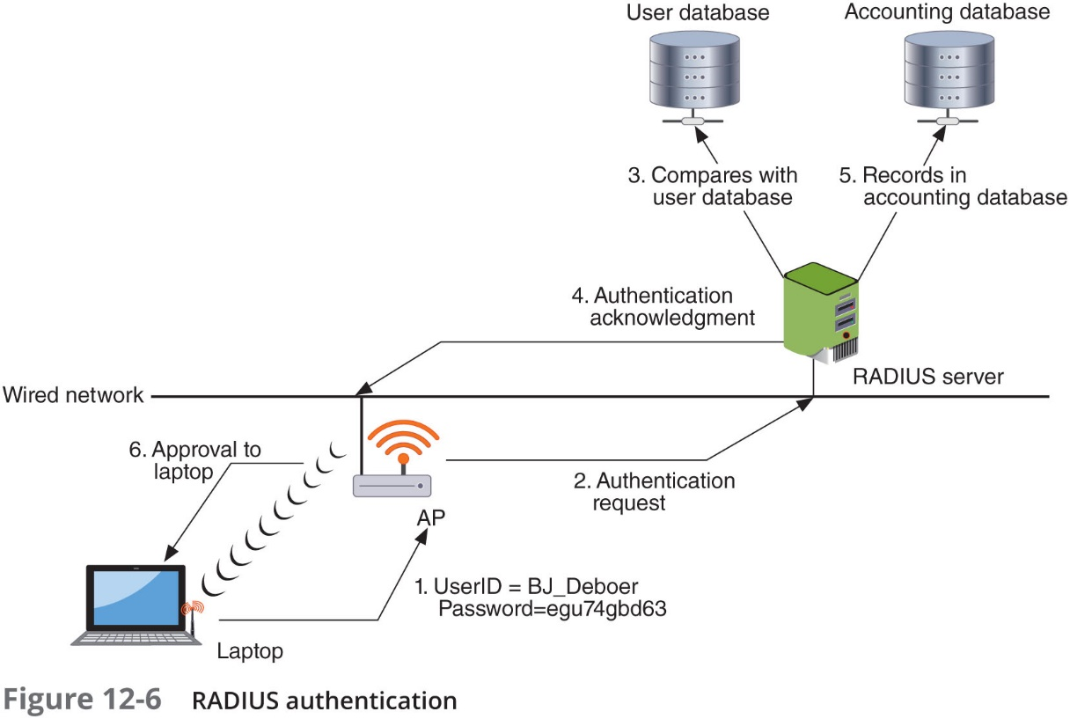
R A D I U S (2 of 2)

Slide 41
Kerberos
Authentication system developed at M I T
Uses encryption and authentication for security
Works like using a driver’s license to cash a check
Kerberos ticket characteristics:
Difficult to copy
Contains information linking it to the user
It lists restrictions
Expires at some future date

Slide 42
Terminal Access Control Access Control System+ (T A C A C S +) (1 of 2)
Authentication service similar to R A D I U S
Commonly used on UNIX devices
Communicates by forwarding user authentication information to a centralized server
The current version is T A C A C S +

Slide 43
Terminal Access Control Access Control System+ (T A C A C S +) (2 of 2)
Feature | RADIUS | T A C A C S+
Transport Protocol | User Datagram Protocol (U D P) | Transmission Control Protocol (T C P)
Authentication and authorization | Combined | Separate
Communication | Unencrypted | Encrypted
Interacts with Kerberos | No | Yes
Can authenticate network devices | No | Yes

Slide 44
Lightweight Directory Access Protocol (L D A P) (1 of 2)
A directory service is a database stored on a network
Contains information about users and network devices
Keeps track of network resources and user’s privileges to those resources
Grants or denies access based on its information
Standard for directory services is known as X.500
Purpose of the standard was to standardize how the data was stored so that any computer system could access directories
X.500 standard also defines a protocol for client application to access the D A P
L D A P

Slide 45
Lightweight Directory Access Protocol (L D A P) (2 of 2)
L D A P
Designed to run over T C P/I P
A simpler subset of D A P
Encodes protocol elements in simpler way than X.500
L D A P traffic is transmitted in cleartext
Can be made secure by using S S L or T L S
Known as Secure L D A P or L D A P over S S L (L D A P S)
Weakness of L D A P
Can be subject to L D A P injection attacks
Similar to S Q L injection attacks
Occurs when user input is not properly filtered

Slide 46
Security Assertion Markup Language (S A M L) (1 of 2)
S A M L
An Extensible Markup Language (X M L) standard that allows secure web domains to exchange user authentication and authorization data
Allows a user’s login credentials to be stored with a single identity provider instead of being stored on each web service provider’s server
Used extensively for online e-commerce business-to-business (B 2 B) and business-to-customer (B 2 C) transactions

Slide 47
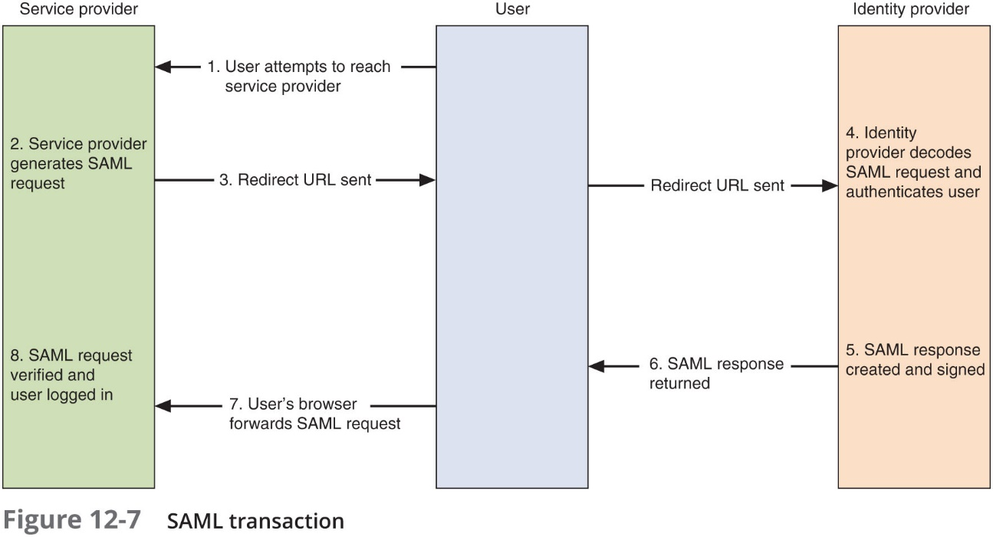
Security Assertion Markup Language (S A M L) (2 of 2)

Slide 48
Authentication Framework Protocols
A framework for transporting authentication protocols is known as the Extensible Authentication Protocol (E A P)
E A P was created as a more secure alternative to:
Challenge-Handshake Authentication Protocol (C H A P)
The Microsoft version of C H A P (M S - C H A P)
Password Authentication Protocol (P A P)
E A P:
Defines the format of the messages
Uses four types of packets:
Request, response, success, and failure

Slide 49
Review Questions
What is the current version of TACACS?
A. XTACACS
B. TACACS+
C. TACACS v9
D. TRACACS
With the development of IEEE 802.1x port security, what type of authentication server has seen even greater usage?
A. RADIUS
B. Lite RDAP
C. DAP
D. RDAP
Which of these is a set of permissions that is attached to an object?
A. Access control list (ACL)
B. Subject Access Entity (SAE)
C. Object modifier
D. Security entry designator

Slide 50
Chapter Summary (1 of 2)
Access control is the process by which resources or services are denied or granted
Five major access control models:
Discretionary Access Control, Mandatory Access Control, Role-Based Access Control, Rule-Based Access Control, Attribute-Based Access Control
Configuring accounts with proper permissions is the first step in providing strong security
Location-based policies establish the geographical boundaries of where a mobile device can and cannot be used
Once accounts have been created, it is important that they be periodically maintained and audited to ensure they still follow all enterprise policies

Slide 51
Chapter Summary (2 of 2)
Best practices for implementing access control
Separation of duties, job rotation, mandatory vacations, and following a clean desk policy
Implementing access control methods includes using access control lists (A C L s)
Different services can be used to provide identity and access services
A directory service is a database stored on the network itself that contains information about users and network devices
One implementation of a directory service as an authentication is the Lightweight Directory Access Protocol (L D A P)

